Slide 1


PLEDGE TO PROGRESS Sustainability Hackathon
Sponsored By
Your Team Name : “Digital Artists”
Your team bio :
Date : 3 May, 2023
Rahul Dogra
Rahul Kadgavkar
Cloud/IT Engineer
Amit Nilajkar
Software & Web Expert
Koushik Karan
Veena Viswanathan
Electronics & IOT Engineer
Analytics & Strategy Expert
Product Design Engineer

Slide 2


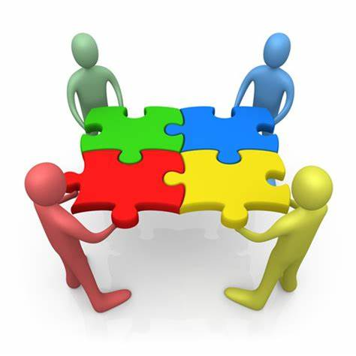



Problem Statement
Situation
Complication
Stakeholders
According to TOI news dated 25 Sep, 2018 you can see ads every 10 m on the stretch of ORR near Lajpat Nagar market. Visual Congestion is highly predominant in the world.
Congestion of a zone manifests into
Eye exhaustion, distraction, disorientation, and other psychological and emotional disturbances in humans.
Disruption of critical behavior in wildlife resulting in impact on bio-diversity.
Visual Pollution is the compounded eﬀect of disorder, and excess of visual disturbances like objects and graphics such as ads, waste, cables in a landscape.
It is a new concern amidst the plethora or other pollution.
Problem Statement
Scope
Hypotheses
Uncontrolled use of large outdoor media surfaces such as Billboards, hoardings in high traffic junctions and on busy roads are one of the causes of visual pollution. Although advertisements constitute an essential part of business, environment and bio-diversity need to be protected..
Outdoor Advertising (OA) such as billboards, hoardings (both physical and digital) seen on the roads.
Developing an Eco-Friendly re-usable alternative would control the use of OA thereby reducing visual pollution.

Slide 3

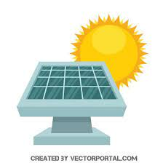

Smart Eco-Friendly External Visual Display on Vehicles
The automobile industry is now being shaped by electrically powered vehicles as it
Solar or other renewable/clean forms of energy combined with innovative display technology can be adopted for utilizing the exterior surface of private and public vehicles as a digital advertisement space.
This alternative option will help reduce visual pollution observed in traditional advertising methods, ensuring physical and mental health in human beings also lowering the impact on bio-diversity. This is a huge opportunity.
Reduces oil demand | Supporting sustainability
Minimizes greenhouse emissions | Resulting in environmental benefits
Lowers Life-Time Ownership Value | Saving cost

Slide 4
User Segment & Challenges
Tie up with MaaS start-ups
Mobility-as-a-Service (MaaS) is an emerging trend
It integrates transportation elements such as trip, capacity, route planning & payment services into a centralised platform
MaaS Mobility-Marketing ecosystem
Integrate Marketing Technology & Operations
Tie-up with the Government
Inbuild the capacity to integrate ICT for e-governance to facilitate speedy administration of information/localised information or content to the public.
Result: Personalised Transportation
Use Smart Infrastructure and inbuild Near-Real-Time capabilities through Artificial Intelligence data
Target the right customer with the right message at the right time
Result:
Additional revenue
Optimal driving decisions
Challenges: Network stability in the countryside, Adoption by marketing organizations.

Slide 5


Alternatives/Competitive products
There is a rise in entrepreneurial wave in the country. “Make in India” and “Startup India” initiatives are churning new ideas and products using novel techniques. Also, providing Near-Real-Time information/news has become the need of the hour. E-Governance could be supported through Information and Communication Technology (ICT) to communicate and relay important & emergency news. Sensors could be used to track the weather, wind speed and support optimized driving and relay local information.
Our idea is novel and the only other alternative/competition is Mobile Marketing. Since we’re talking about NRT possibilities this is also not a strong competition. Mobile ads reach the target audience only upon usage of the mobile device to browse or open a relevant app.
Marketing leaders are also constantly looking for ideas that would help them relay their communication in a more proactive and real-time manner.

Slide 6
Tools or resources
Hardware:
Used 2-wheeler or 4-wheeler (subject to availability)
E-paper display connected to Raspberry pi 4
Electronic systems, networking devices etc., with chip development and testing facility for low power consumption display technology.
Software and internet tools:
Azure IoT Hub and Azure Networking Services are required for enabling inter-connected device framework to be implemented in product design. Azure Sphere & Azure RTOS will be utilised for designing & testing
MS SQL will be used as backend customer database sever with Microsoft AI applications and SQL Studio (SSMS)
Microsoft OneDrive & Microsoft Azure for cloud implementation to make real time information available
Microsoft Teams & Office for virtual team collaboration & project management

Slide 7
Solution & Methodology
Location based ICT (e-governance) & Marketing data
For Ads and Real-Time Info/News
Wireless Module for Input Connected through app via user’s mobile
Raspberry Pi 4/ Other
Dev
Board
E-Ink/OLED Display for output
IoT data/Data from MaaS
ADAS/Data from Sensors

Slide 8















Architecture
Microsoft Teams, Microsoft OneDrive and Microsoft Office for Project Management and virtual team collaboration
Data Sources
1
Orchestration
2
3
AI based NRT
Output
4
Ingestion
Architecture
Microsoft
SQL Server
with SSMS
Data Storage
Analysis
Output
Marketing
Weather/Road condition, etc.
On Device Sensors Data
Advanced Drive Assistance System (ADAS) data
Prep/Train
E-ink/OLED
Display
ADAS Data
Authentication
E-governance
data
Government
ICT Data
Artificial Intelligence/
Machine Learning
Azure Sphere, Azure RTOS
MaaS
data
MaaS
Azure Networking Services
Azure Active Directory

Slide 9
Key Differentiators
Adoption Plan
Onboard
MaaS
Smart Infrastructure
Launch
Drive Value
Monitor Adoption
Further Engagement
Test Prototype with Early Adopters
Automobile Industry
Government
Marketing department of target companies
Measure and Report Usage
Data & Technology based, Location based decisions
Near-Real-Time
Artificial Intelligence supported
Azure Cloud Technology

Slide 10
Scalability & GitHub Link
The future may also be revolutionized by AI powered Autonomous Vehicles and flying cars.
Many prototypes are already being tested by researchers in different parts of the world.
There is a huge opportunity. The concept could be an integral part of the product.
GitHub Repository Link:
https://github.com/rahuldogranit/Digi-Artists

Slide 11
Thank You
Our heartfelt gratitute to the following members who provided external support for our project:
Mohammed Aamid – Mechanical Design Expert & Technical Advisor
Vani Soni – 3D Designer

